Slide 1
Java Architecture
Understanding the Layers of Java
-Sanskriti Bhokare
-Gitanjali More
-Pratiksha Sapkale

Slide 2
Introduction to Java
Java is a high-level, object-oriented programming language.
It is known for its platform independence, security, and robustness.
Key principle: Write Once, Run Anywhere (WORA).

Slide 3
Layers of Java Architectur
Java Architecture:
Java Source Code (.java files)
Java Compiler (Javac) -> Bytecode (.class files)
Java Virtual Machine (JVM) -> Executes Bytecode
Java Runtime Environment (JRE)
Java Development Kit (JDK)

Slide 4
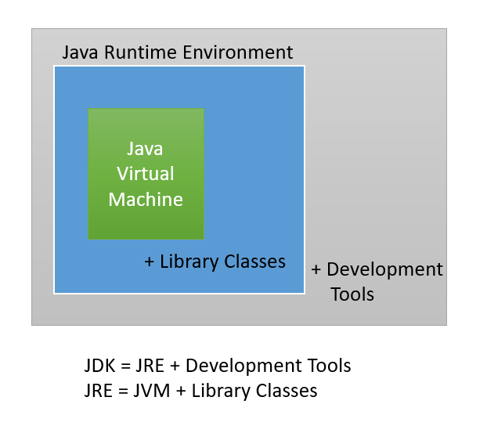
Java Architecture

Slide 5
Java Development Kit (JDK)
Purpose: It provides tools for Java development like the compiler (javac), debugger, and other utilities.
Includes the Java Runtime Environment (JRE) and development tools.
Components:
Compiler (javac)
Debugger (jdb)
Java libraries (APIs)

Slide 6
Java Runtime Environment (JRE)
Purpose: It's the environment required for running Java applications.
Consists of JVM and Java class libraries.
Components:
JVM: Executes the bytecode.
Class Libraries: Standard classes for various functionalities (I/O, networking, etc.).

Slide 7
Java Virtual Machine (JVM)
Role of JVM:
Converts bytecode to machine code.
Java’s platform independence is due to the JVM.
Key Features:Class Loader:
Loads bytecode into the JVM.
Execution Engine: Interprets or JIT-compiles bytecode.
Garbage Collection: Manages memory automatically.

Slide 8
Conclusion
Recap:
Java's architecture makes it platform-independent, secure, and robust.
The JVM, JRE, and JDK are the core components of Java architecture.
Final Thought: The power of Java lies in it’s architecture that ensures efficient and secure application execution across multiple platforms.

Slide 9
Thank You

